Slide 1
CS660 Lab 4 Group 9
Alexys Lamkin, Michael Karaman, Yiyun Zhang

Slide 2
Problem, Assumptions, and Design Overview

Slide 3
Problem
Component failures
Huge files
File mutated
Increasing flexibility

Slide 4
Assumptions
The system is built from many inexpensive commodity components that often fail. So the system must constantly monitor itself and detect, tolerate, and recover promptly from component failures on a routine basis.
The system stores a modest number of large files. Multi gigabytes files are common and should be managed efficiently, while small files must be supported without optimization.
The workloads primarily consist of two kinds of reads: large streaming reads and small random reads. Small reads should be batch and sorted to advance steadily instead of going back and forth.
Large, sequential writes that append data to files and read size are similar to typical operation sizes. Small writes at arbitrary positions in a file are supported but no need to be efficient.
The system must efficiently implement well-defined semantics for multiple clients that concurrently append to the same file.

Slide 5
Design Overview
Interface - create, delete, open, close, read, write, snapshot, record, append
Architecture - single master, chunk servers, multiple clients
Single Master - chunk placement and replication
Chunk size - 64MB
Metadata - namespaces, mapping, locations
Consistency Model - Distributed, simple and efficient

Slide 6
Detailed Design and Implementation

Slide 7
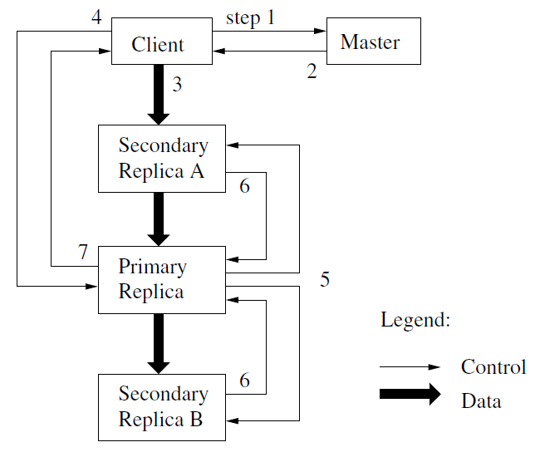
System Interactions - Control Flow
Mutations - change in chunk
Lease - Master assigns one replica of a chunk as Primary
Client asks lease location
Master gives all Replica locations
Client pushes data
Client pushes write request to Primary
Primary pushes write request to Secondaries
Secondaries inform Primary when done
Primary reports to Client

Slide 8
System Interactions - Data Flow
Decoupled from control flow
Goal - maximze bandwidth utilization
Goal - minimize latency
Linear Chain
Send to closest
Pipelining

Slide 9
System Interactions - Record Appends and Snapshots
Record Append
Atomic - done in one continuous sequence of bytes (cannot be interrupted)
Record Append - garentes to appends data to file atomically at least once
Atomic nature of record append avoids additional synchronization
Same control flow (1 exception)
If append data would overflow chunk (chunk > 64MB), try at next chunk
Any record failing append on any replica causes client to retry operation
Snapshot
Copy file/directory tree (source) with minimal disruption
E.g. source = chunk C
Upon snapshot request:
Master revokes lease on C
Master logs request
Master copies metadata for C (still pointing at C)
Some time in future:
Client requests write to chunk C
Master instructs servers to duplicate C as C’
Master returns lease for C’

Slide 10
Master Operation
Read/write locks on namespace allow for multiple active operations on the master
Chunk Management
Chunk replicas are spread across different server racks for reliability
Chunk replicas created on nodes with the most free disk space
Low number of recent creations on each chunkserver/rack
Master maintains chunk version number
Stale replicas removed in garbage collection
Garbage Collection (delayed)
File deletion is just a file rename
Metadata for these files eventually deleted
When all files in chunk have no metadata, chunk metadate is erased
Master allows for deletion of replicas of orphan chunks

Slide 11
Fault Tolerance and Diagnosis
High Availability
Fast recovery
All servers restore state from cold in seconds
No special shutdown procedures
Chunk replication
Master replication
Master operation log and state checkpoints replicated on multiple machines
Read only shadow masters
Data Integrity
Checksumming used to detect corrupt data
Checksums managed by chunkservers
Optimized for appends
Diagnostic Tools
Diagnostic logs kept

Slide 12
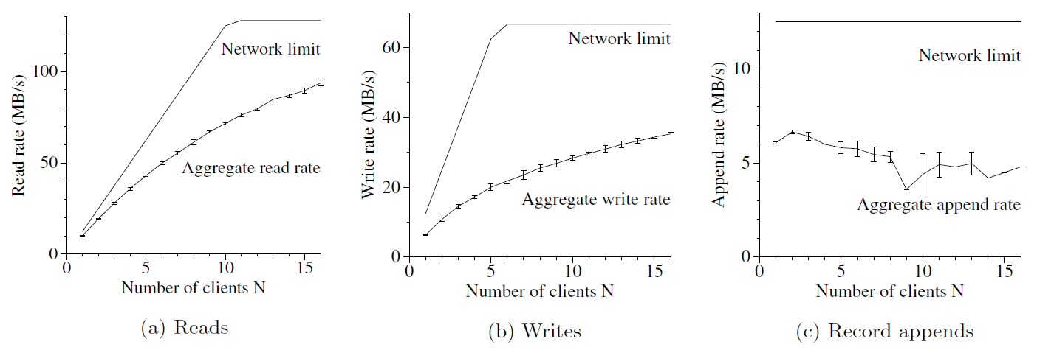
Performance Summary

